Slide 1
Machine learning tutorial with applications in bioimaging.
David ROUSSEAU
LARIS, IRHS UMR INRA, 62 Avenue Notre Dame du Lac, 49000 Angers, France
david.rousseau@univ-angers.fr
Toulouse 11 march 2019
1

Slide 2
Who am I? … like all of us data scientists
D. Rousseau

Slide 3
Roadmap
What is machine learning?
What is different or similar in the Era of machine learning based Bioimaging ?
What are the families of methods and their basic principle?
Is it ready to use in Bioimaging?
What are possible pitfalls and bottleneck ?

Slide 4
What is machine learning ?
A method of artificial intelligence
Very trendy since 2012
Capable of achieving complex informational tasks

Slide 5
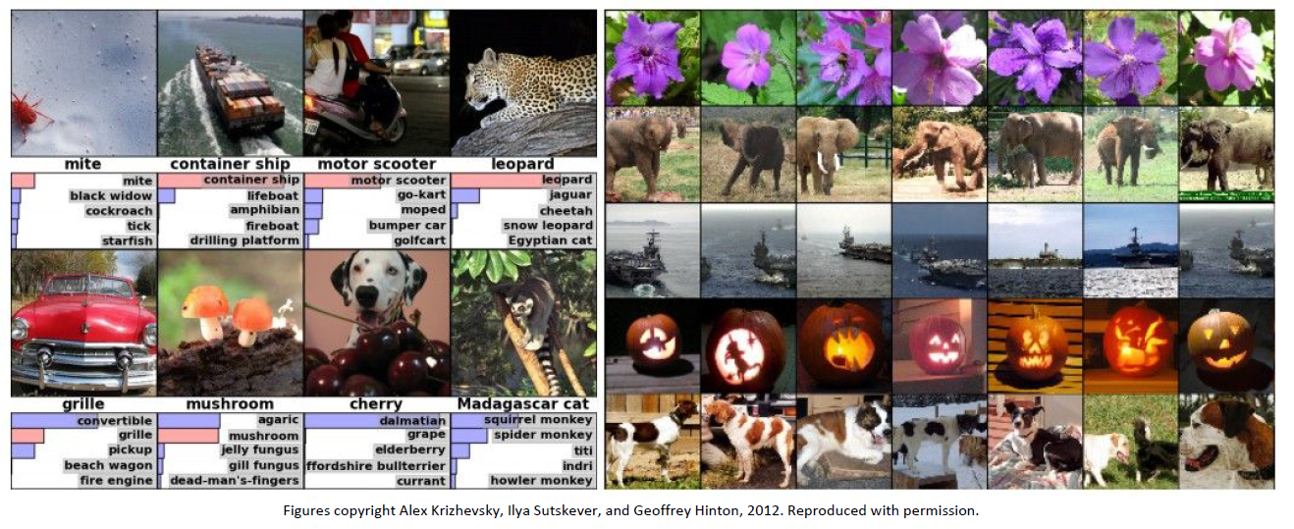
Example of machine learning capabilities
Classification
Retrieval

Slide 6
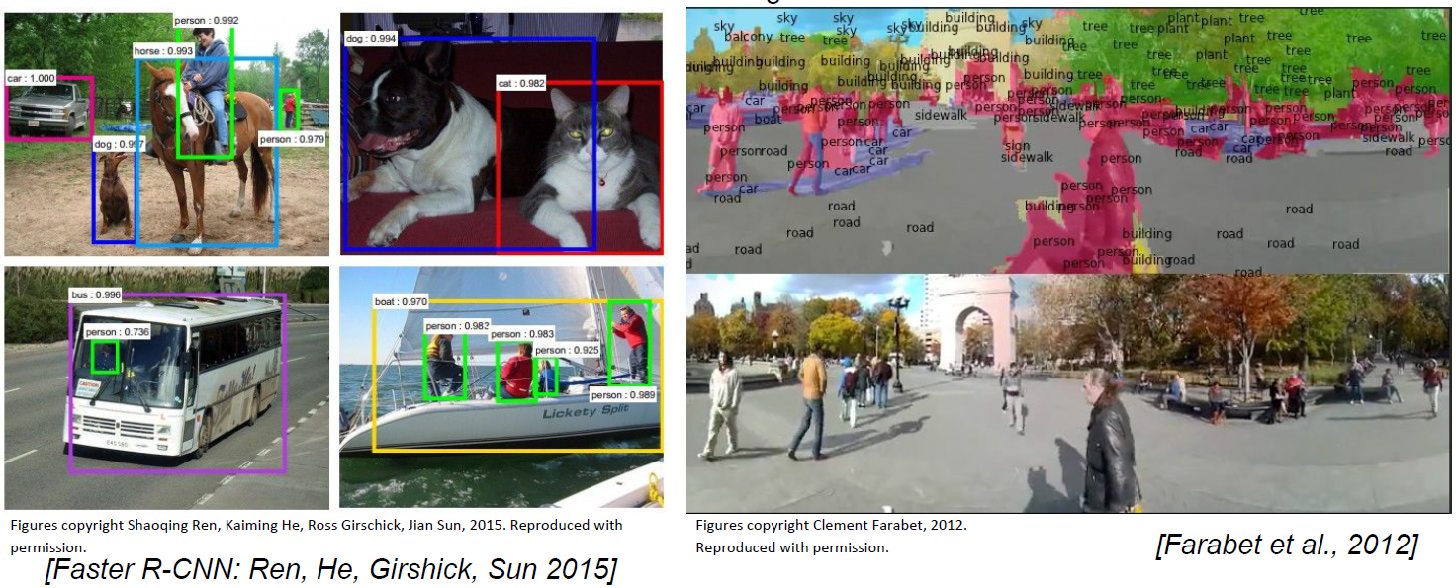
Example of machine learning capabilities
Detection
Segmentation

Slide 7
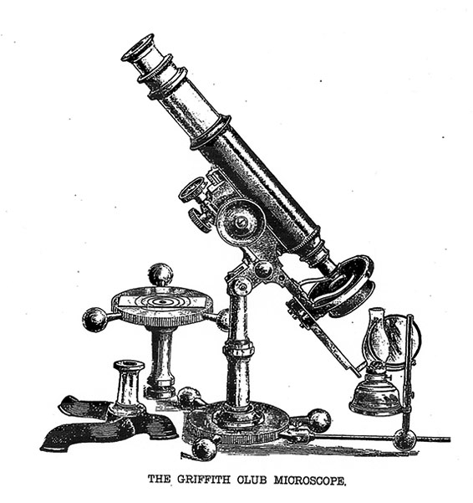
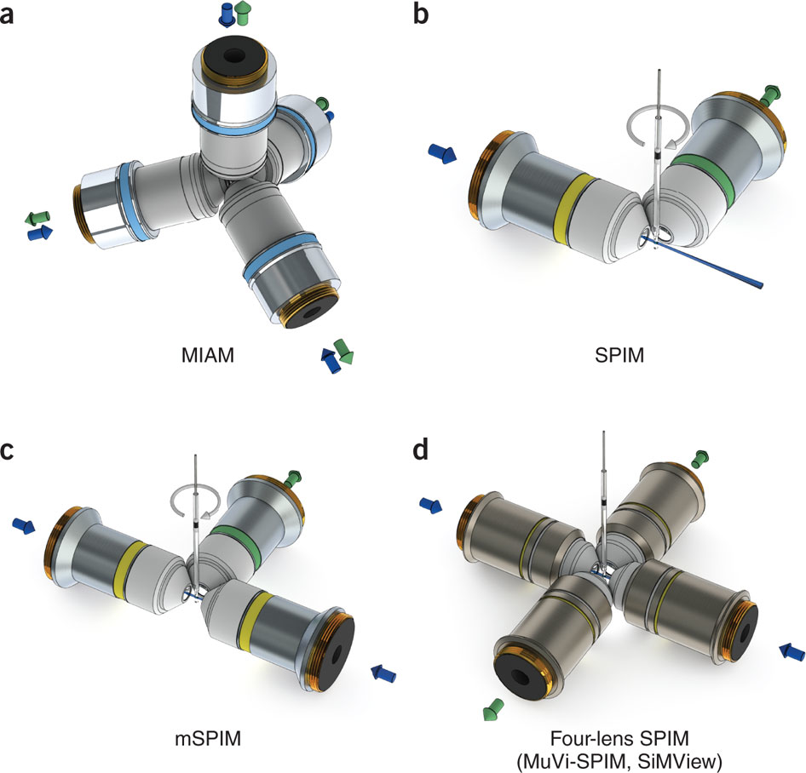
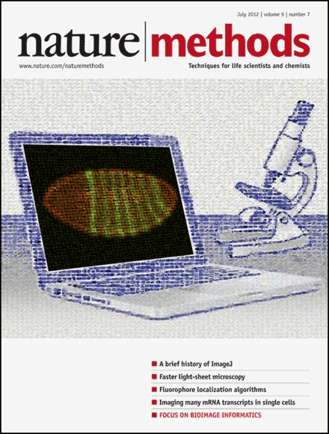
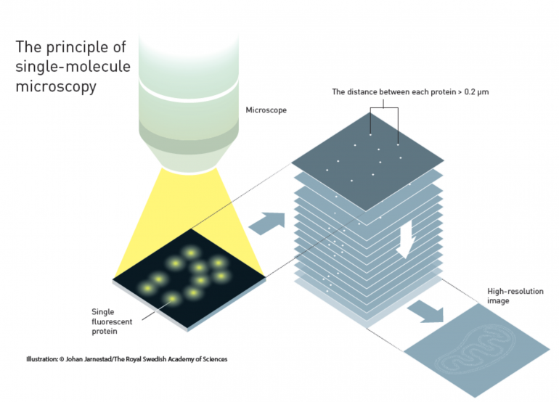
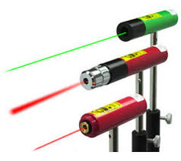
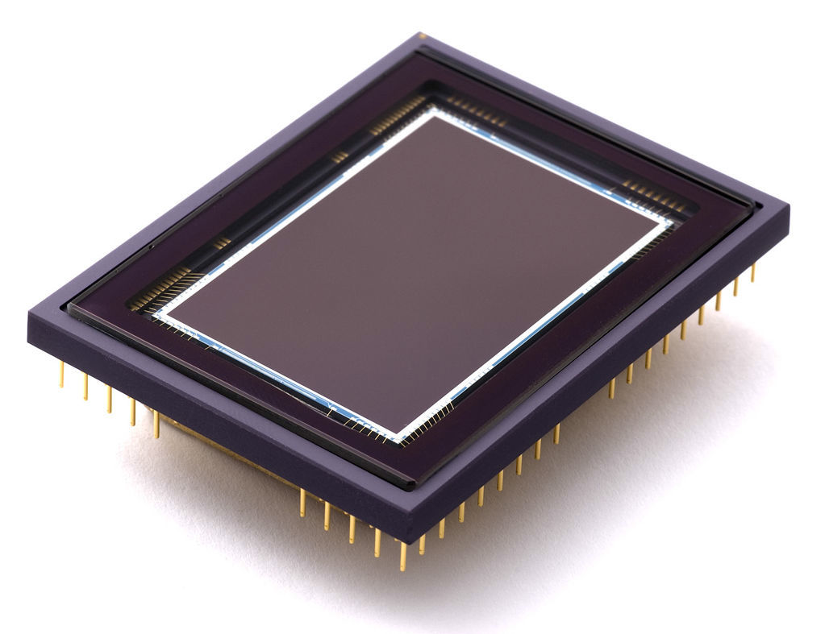
Microscopy in machine learning ?
A domain which produces a lot of images
With high heterogeneity in tissue and contrast
=> Adapted to machine learning and deep learning
Some review articles for deep learning in microscopy:
Angermueller C, et al Deep learning for computational biology. Molecular systems biology. 2016 Jul 1;12(7):878.
Rivenson Y, et al. Deep learning microscopy. Optica. 2017 Nov 20;4(11):1437-43.
1590
1960
2004
2012
2014
STED
16

Slide 8
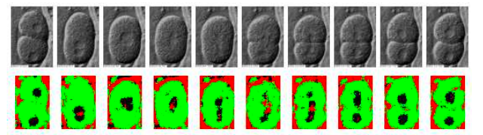
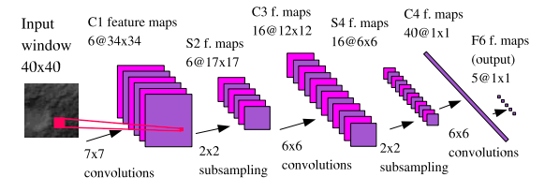
Pixel level classification
Ning, Feng, et al. "Toward automatic phenotyping of developing embryos from videos." IEEE Transactions on Image Processing 14.9 (2005): 1360-1371.

Slide 9
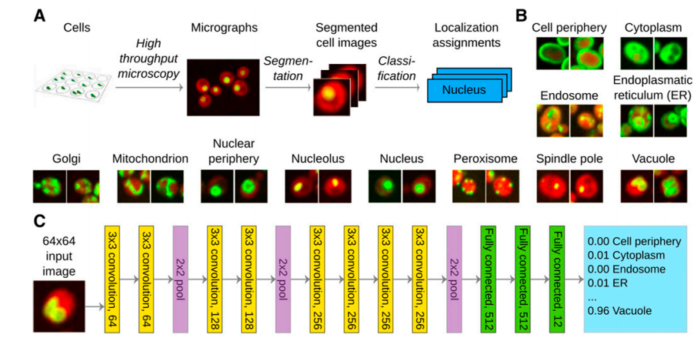
Classification at larger scale
Pärnamaa, Tanel, and Leopold Parts. "Accurate classification of protein subcellular localization from high-throughput microscopy images using deep learning." G3: Genes, Genomes, Genetics 7.5 (2017): 1385-1392.

Slide 10
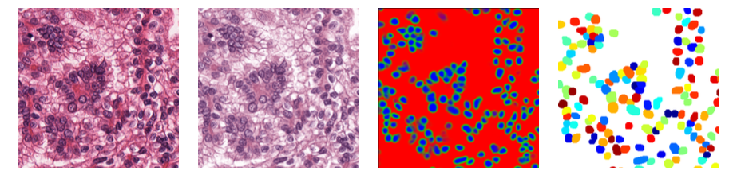
Specific application domain
Histology
Cui, Yuxin, et al. "A Deep Learning Algorithm for One-step Contour Aware Nuclei Segmentation of Histopathological Images." arXiv preprint arXiv:1803.02786 (2018).
Cui, Yuxin, et al. "A Deep Learning Algorithm for One-step Contour Aware Nuclei Segmentation of Histopathological Images." arXiv preprint arXiv:1803.02786 (2018).
Works well because
large amount of annotated data
* Easy data augmentation with color dithering and deformation

Slide 11
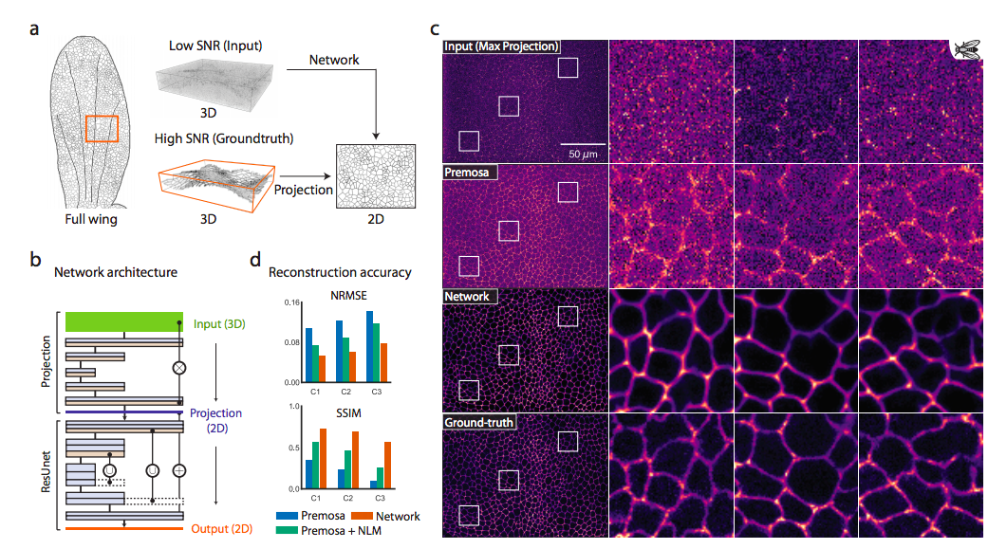
Image denoising
Weigert, M., et al 2018. Content-aware image restoration: pushing the limits of fluorescence microscopy. Nature methods, 15(12), p.1090.
Works well because
Difference in frequency between noise and structures
* Easy data augmentation with physical simulator

Slide 12
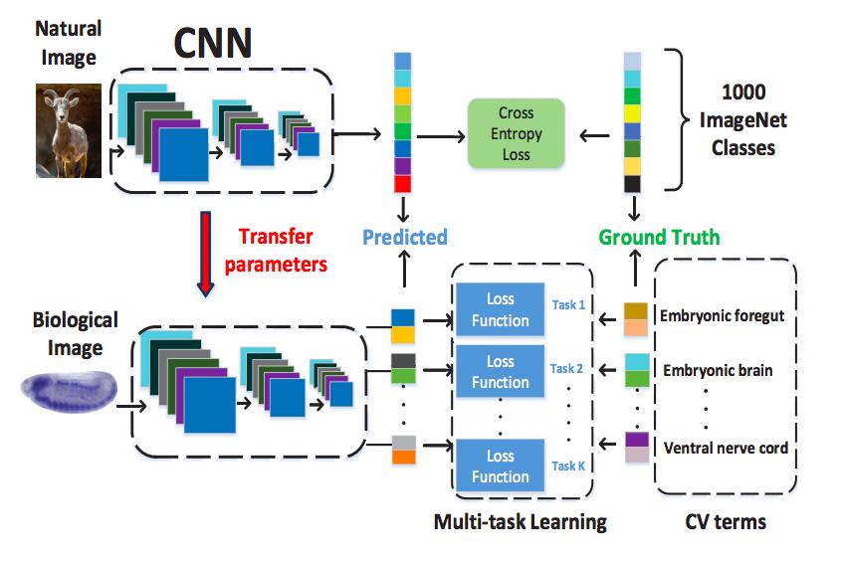
Transfer learning
Zhang, Wenlu, et al. "Deep model based transfer and multi-task learning for biological image analysis." IEEE Transactions on Big Data (2016).

Slide 13
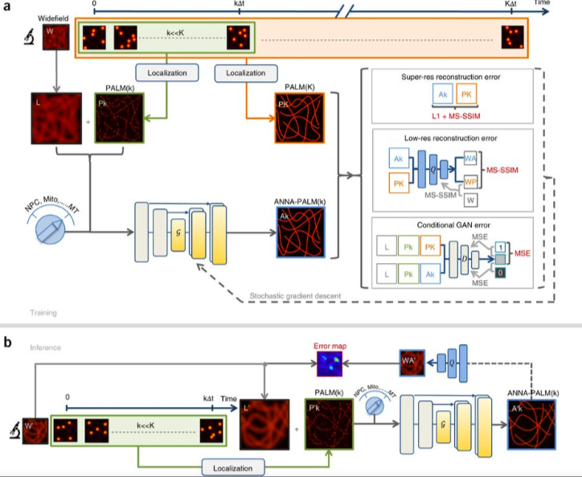
Super-resolution
Ouyang, Wei, et al. "Deep learning massively accelerates super-resolution localization microscopy." Nature biotechnology (2018).

Slide 14
From expert based to machine learning
Pixels
A 1D model of an image

Slide 15
Filtering as basic tool of expert bioimage analyst
Input image X
Filtered image Y
X(1)
W(-2)
Y(1)
X(2)
W(-1)
Y(1)
+
W(0)
W(+1)
W(+2)
X(i)
Y(i)

Slide 16
Filtering as basic tool of expert bioimage analyst
Input image X
Filtered image Y
X(1)
Y(1)
X(2)
Y(1)
W(-2)
W(-1)
W(o)
+
W(+1)
X(i)
W(+2)
Y(i)

Slide 17
Filtering as basic tool of expert bioimage analyst
Input image X
Filtered image Y
X(1)
Y(1)
X(2)
Y(1)
W(-2)
W(-1)
X(i)
W(o)
+
Y(i)
W(+1)
W(+2)

Slide 18
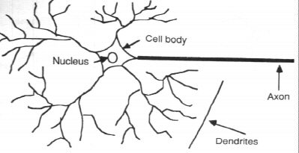
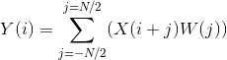
Filtering as basic tool of expert bioimage analyst
Input image X
Filtered image Y : feature
X(1)
Y(1)
In neurosciences : pooling
X(2)
Y(1)
W(-2)
W(-1)
X(i)
W(o)
+
Y(i)
W(+1)
W(+2)
In electrical engineering : convolution

Slide 19
Filtering as basic tool of expert bioimage analyst
Input image X
Y1
Filter 1

Slide 20
Filtering as basic tool of expert bioimage analyst
Input image X
Feature
Y1
Output image Z
Filter 1
A classifier
A regression

Slide 21
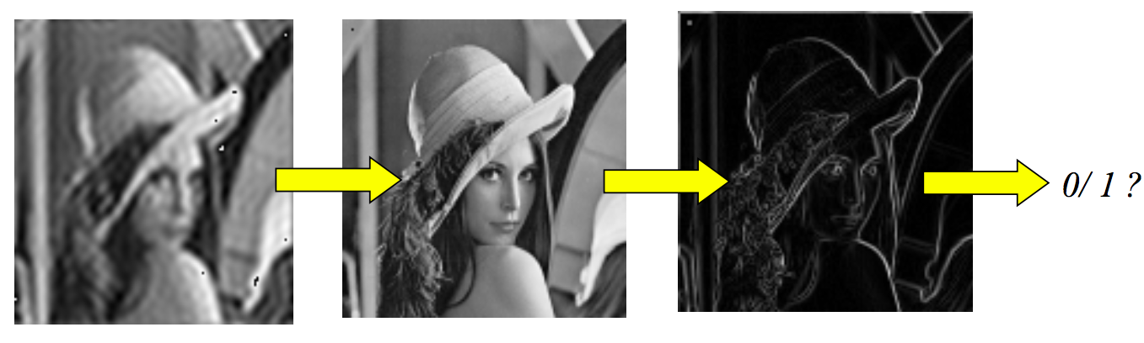
Visual illustration
Raw image
X
Y feature
Decision

Slide 22
The simplest classifier
Thresholding an histogram transformation to produce two classes of pixel :
The ensemble of pixels lower than the threshold: classe 0
The ensemble of pixels larger than the threshold: classe 1 (or 255 for ImageJ friends)
How to select threshold?
N
N
N_{G}
N_{G}
Threshold
0
255
0
255

Slide 23
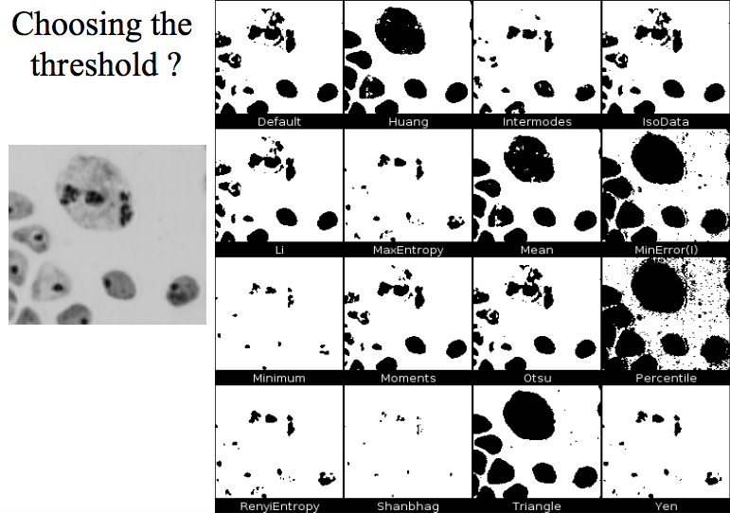
« A la papa » style a.k.a « Autothreshold in IJ »

Slide 24
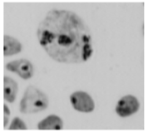
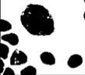
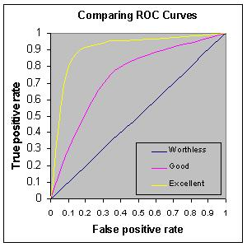
Where the machine can help
Take a training set of images with annotated ground truth
Test all possible thresholds and compute a ROC curve
Ask the machine to select the best threshold

Slide 25
When dimension increases…
Input image X
Y2
Y1
Filter 2

Slide 26
…Expert capabilities are overwhelmed…
Input image X
Y2
Y1
YM
Filter M

Slide 27
…. and machine can help
Input image X
Y2
Y1
YM
Output image Z
M filters
A classifier
A regression

Slide 28
Classical machine learning
Input image X
Y2
Y1
YM
Output image Z
M filters
A classifier
A regression

Slide 29


Classical machine learning a.k.a « A la Kota »
Input image X
Y2
Y1
YM
Output image Z
Expert
M filters
A classifier
A regression
Machine

Slide 30
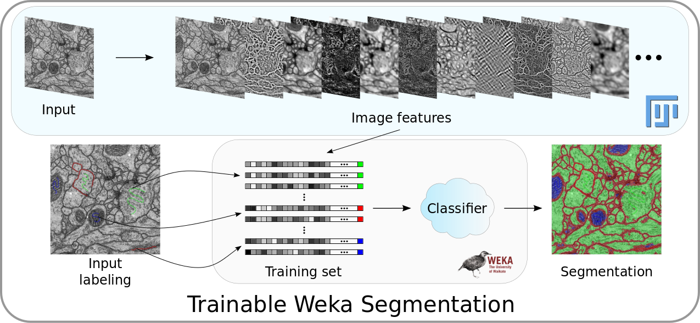
What you do with Weka, Illastik, Labkit, ZEN, …

Slide 31

one step further … Deep learning

Slide 32
Take home message 1
Machine learning is not new tool but automation of existing ones
Pretty helpful for large datasets and hard problems
When large feature spaces are requested to solve the problems
The larger the feature space the larger the need of annotated data sets
As a consequence annotation is the new bottleneck in bioimage analysis

Slide 33
Why deep learning?
Empirically Curves crosses at 10^4 instances

Slide 34
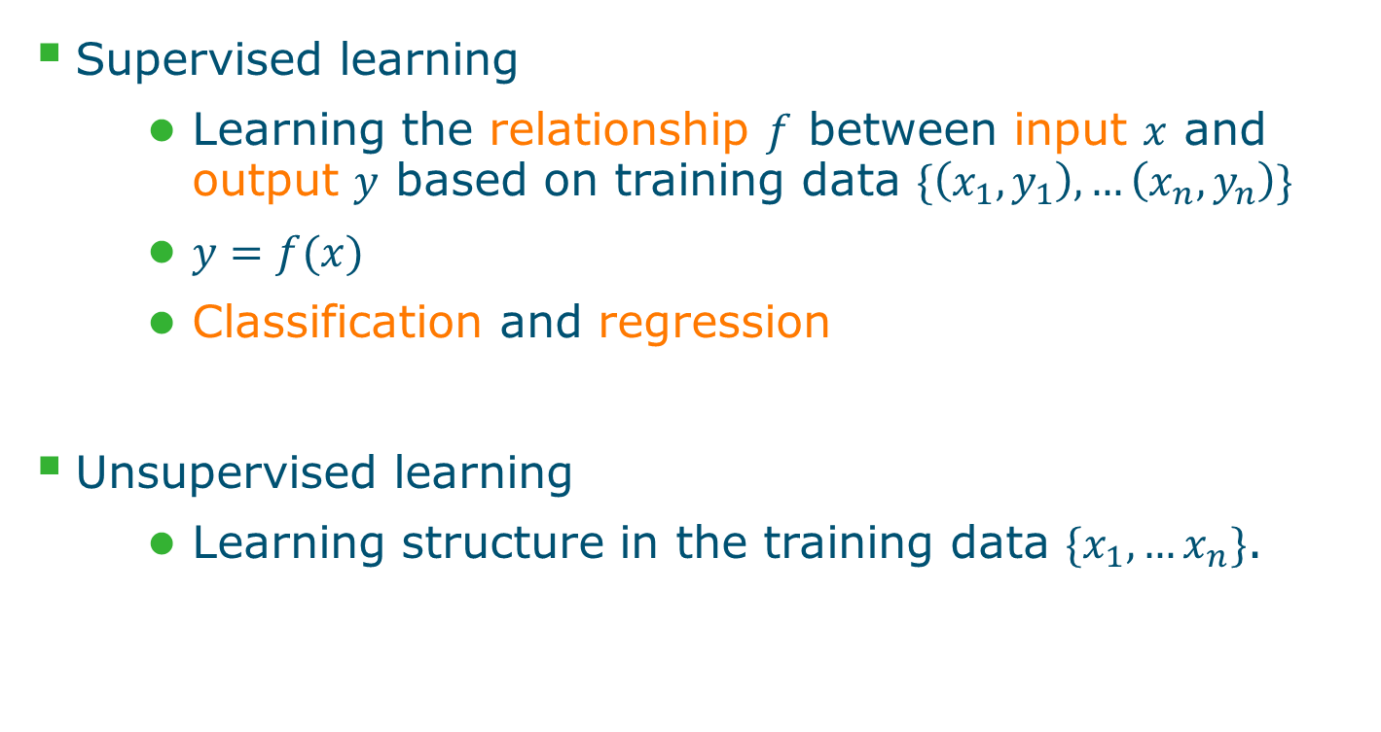
Two main types of machine learning algo.

Slide 35
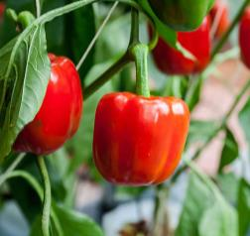
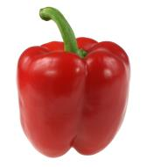
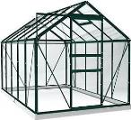

Supervised Classification
New image
Detected object
Object database
Representation/ Object feature
Distance measure
Example=K-NN
Feature Space

Slide 36
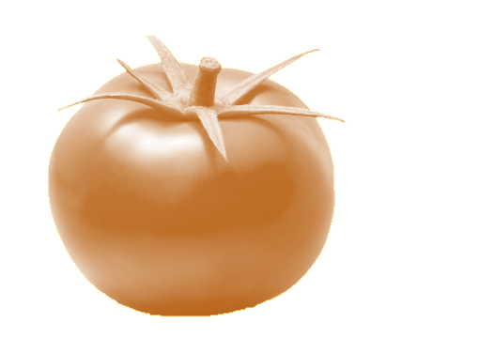
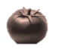


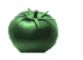
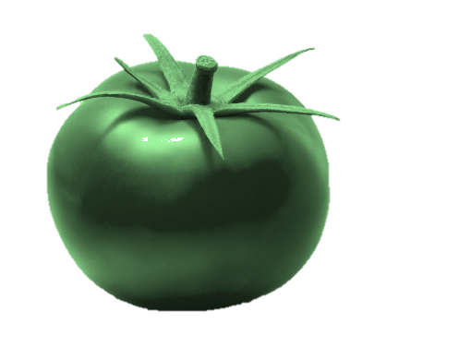
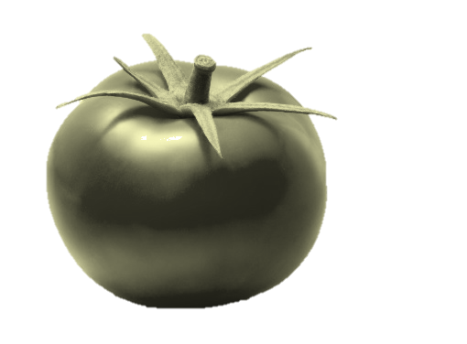


Supervised Regression
New image
Regression model
Ripeness: 6.2
Ripeness
Hue value
Ripeness:
3.2
5.8
8.1
11.3

Slide 37
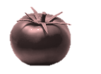


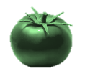
Unsupervised learning
Clustering
Structure
Cluster 1
Cluster 2
Dimensionality reduction
Cluster 3

Slide 38
Unsupervised machine learning algo.
Clustering
K-Mean
Gaussian Mixture Models
Hierarchical clustering
Mean-shift
Kohonen Self-Organizing Maps
...
Dimensionality reduction
Principle Component Analysis
Neural Networks Auto-encoders
GP-LVM
...
We’ll look at k-Means and GMM for clustering and segmentation

Slide 39
K-Means clustering
Iterative method to cluster your data
Initialization: pick k random cluster centroids
Based on the centres, assign all points to a cluster
Based on the assignments, recalculate the centroids
Repeat 2-3 until convergence

Slide 40
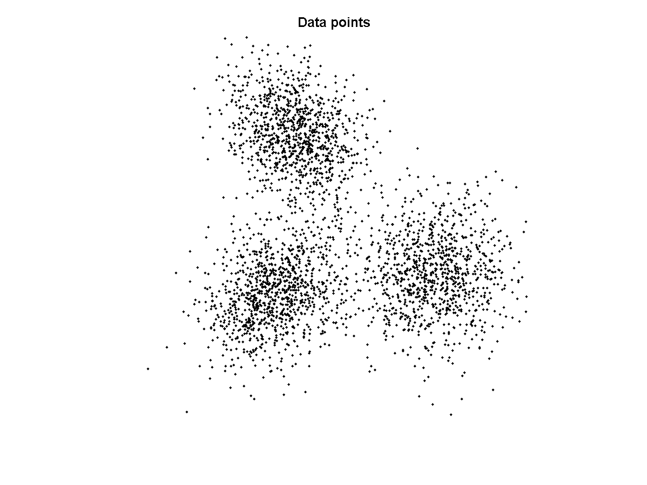
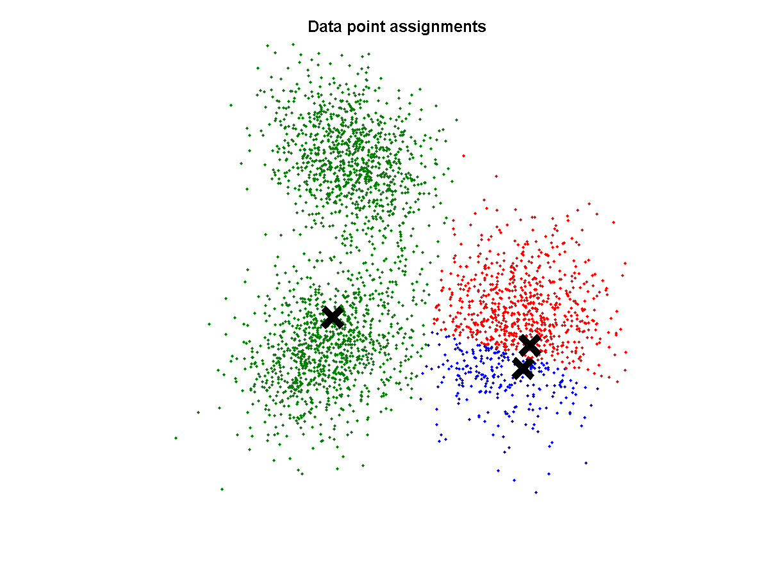
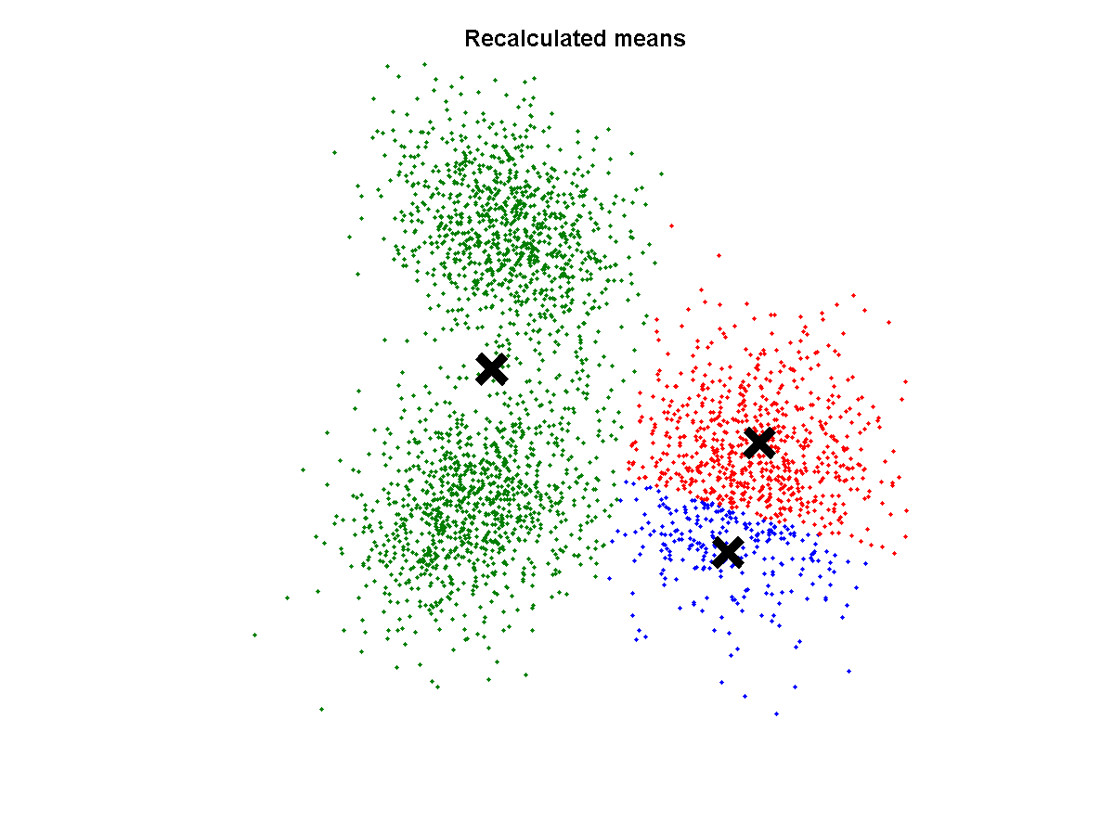
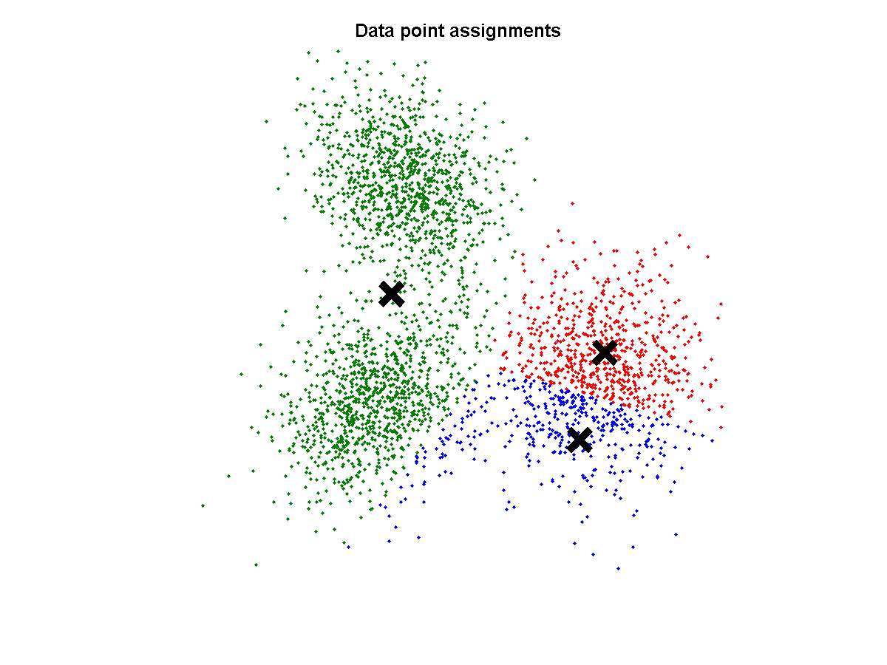

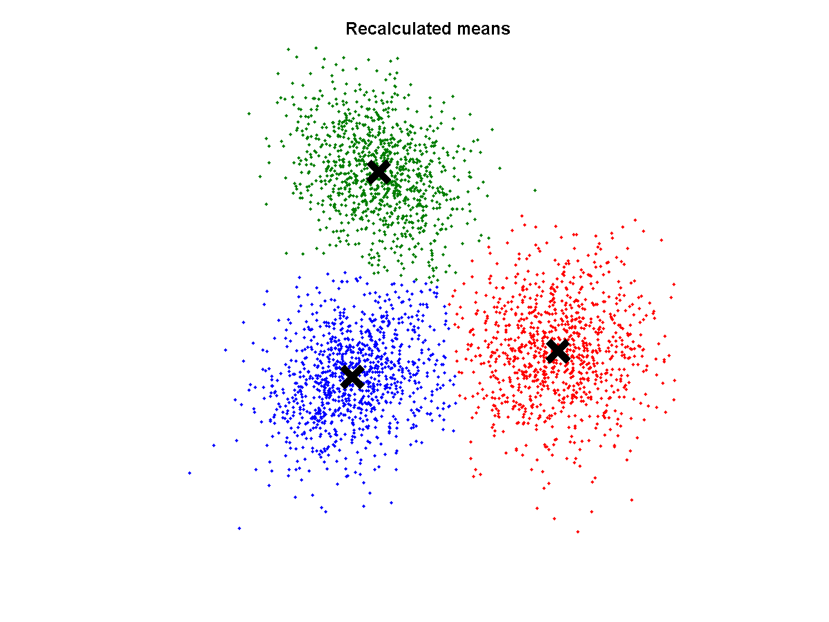


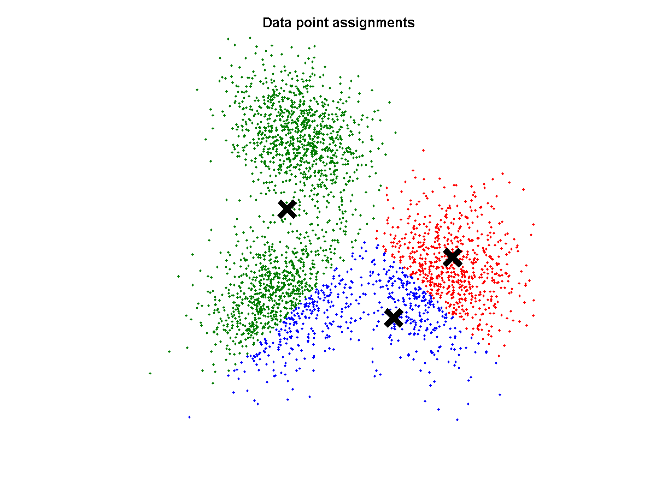
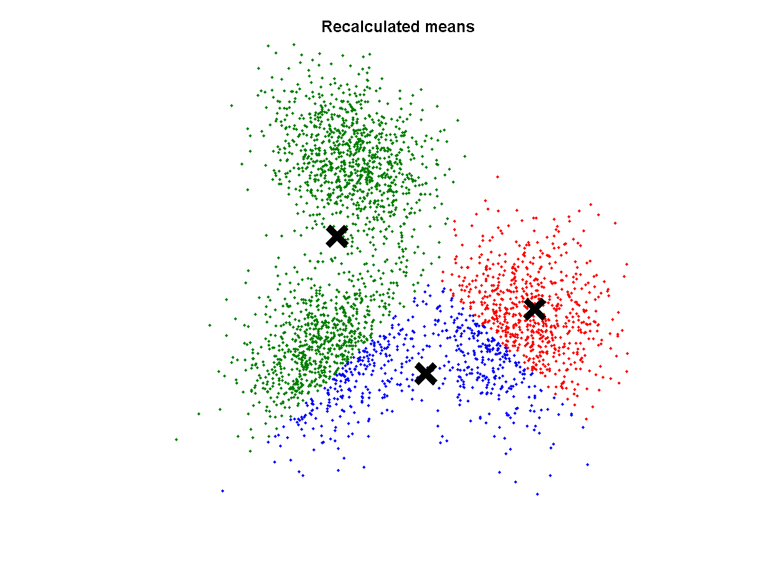
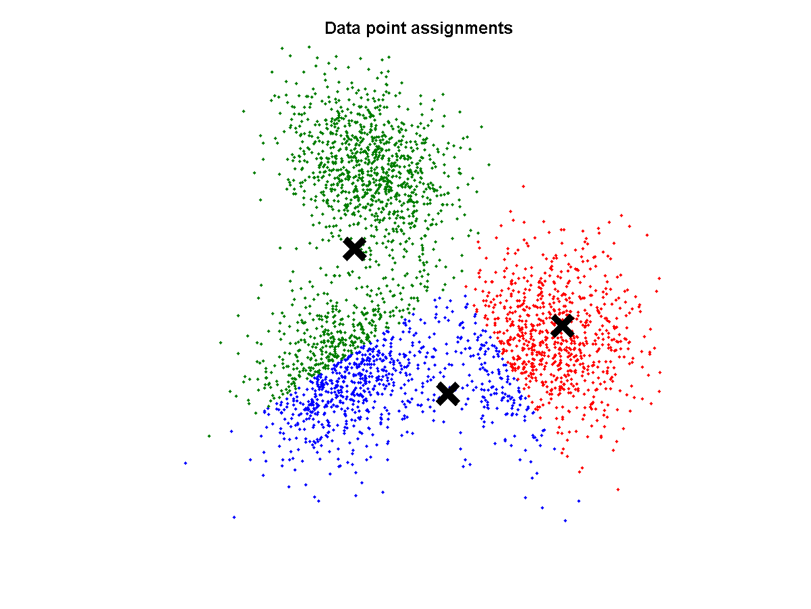
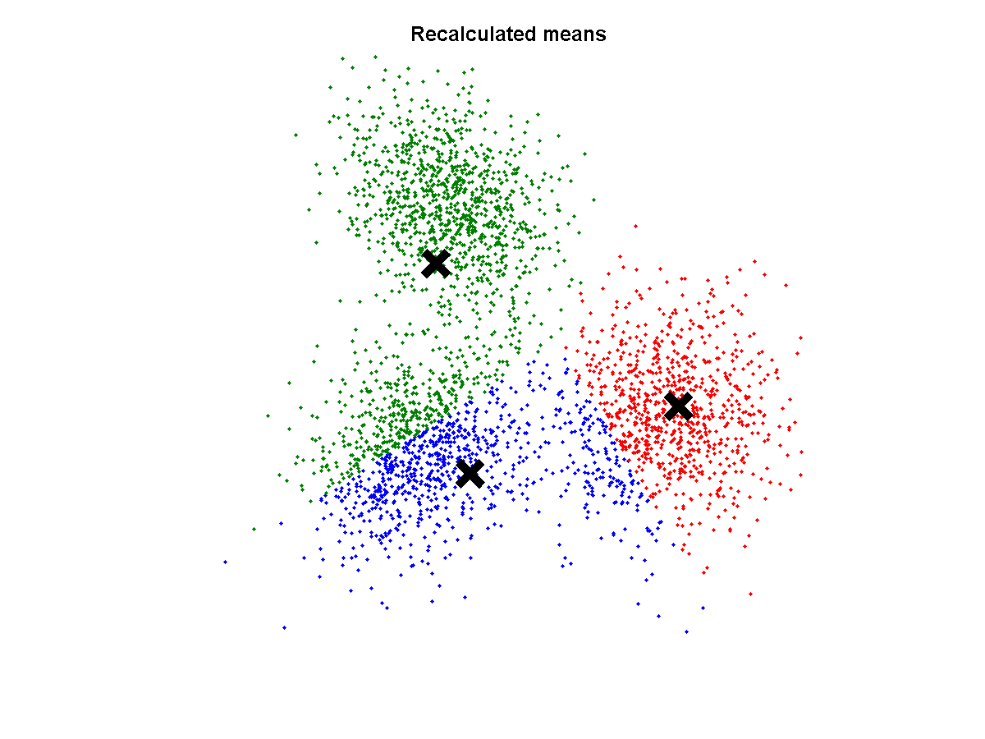
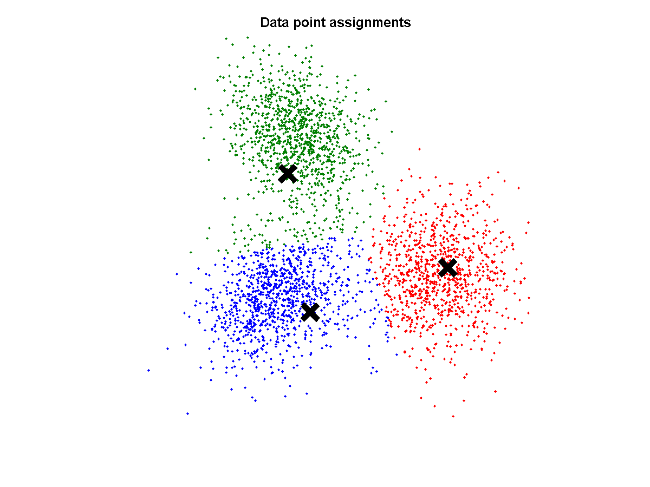










Example of k-Means clustering
Converged

Slide 41
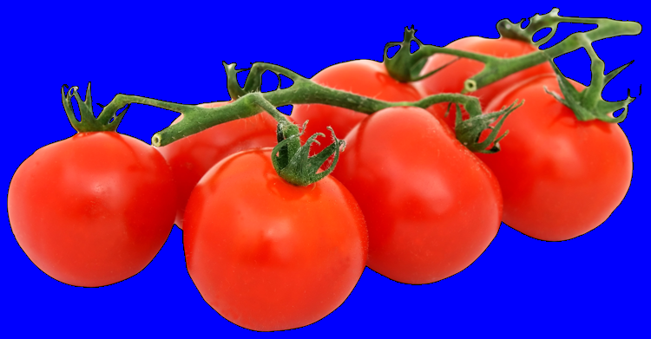
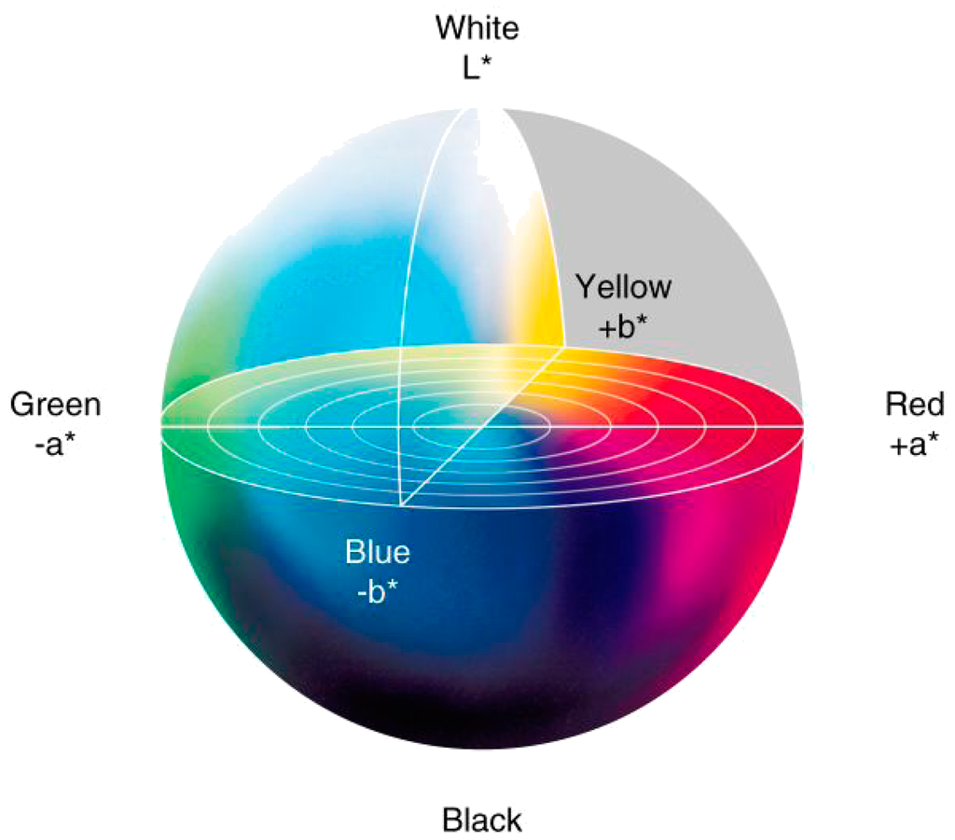
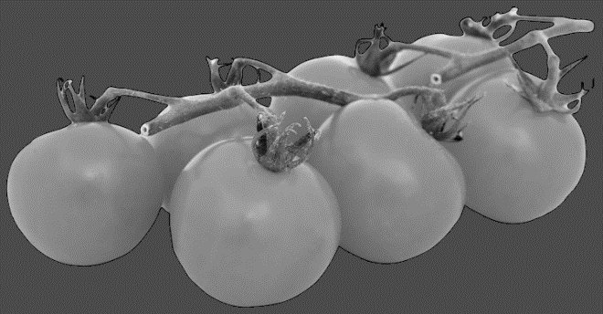
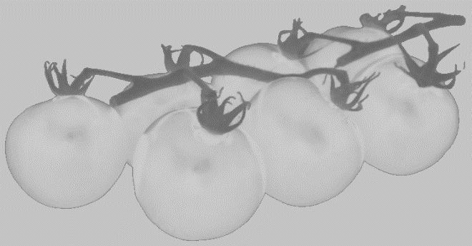
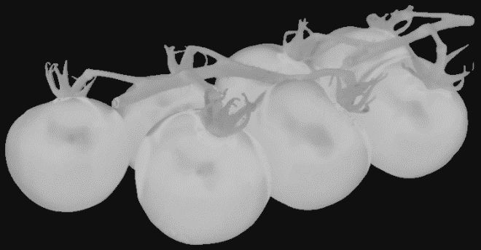
K-means to segment and image
Transforming to CIE L*a*b* colorspace
To better deal with shadows
Luminance
a*
b*

Slide 42
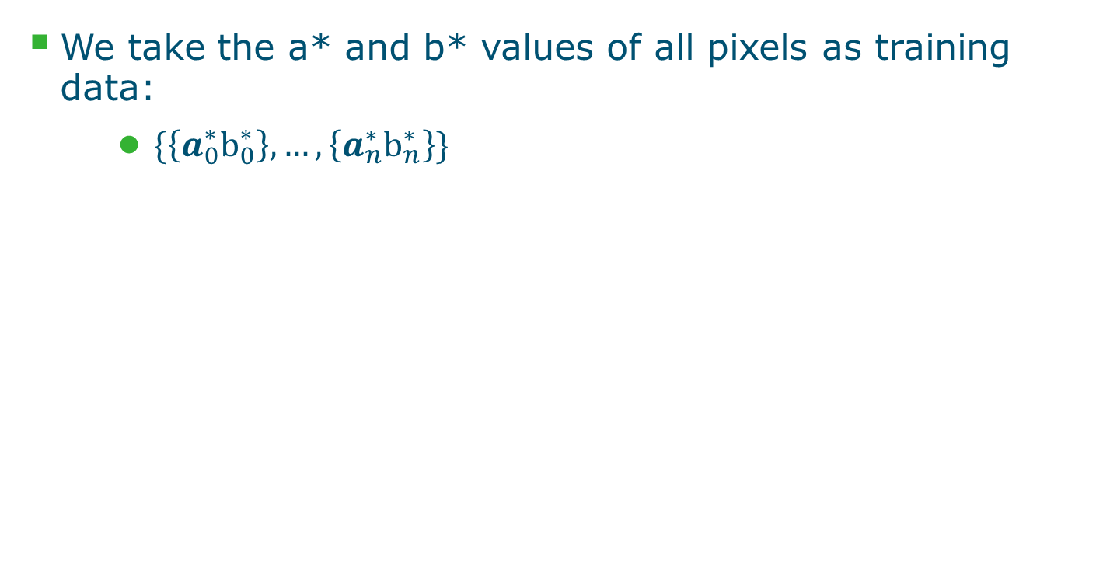

K-means to segment and image

Slide 43





K-means to segment and image
Clusters in a*b* space
Resulting segmented image
http://ij-plugins.sourceforge.net/plugins/segmentation/k-means.html

Slide 44














When K-means goes wrong … GMM
k-Means clustering assumes (hyper)spherical distributions
Only based on distance from cluster centres
Does not take the distribution of points into account
..., but to the wrong solution

Slide 45

Warning : malédiction de la grande dimension

Slide 46
Supervised machine learning
Decision Trees
Random Forests
Artificial Neural Networks
K Nearest Neighbors
Support Vector Machines
Gaussian Processes
...
We’ll look at Decision Trees, Random Forests and Artificial Neural Networks

Slide 47
Decision tree
6
The (binary) decision tree
5
4
x₁>3
x₂
3
2
x₂>3
1
x₂>2
1
2
3
4
5
6
7
8
x₁
x₁>6
x₁>7

Slide 48

Decision tree learning

Slide 49

Example
6
 | #O1 | #X1 | #O2 | #X2 | Gini1 | Gini2 | Gini
X₁>1 | 1 | 1 | 6 | 7 | 0.50 | 0.50 | 1.00
X₁>3 | 3 | 3 | 4 | 5 | 0.50 | 0.49 | 0.99
X₁>4 | 4 | 4 | 3 | 4 | 0.50 | 0.49 | 0.99
X₁>5 | 4 | 5 | 3 | 3 | 0.49 | 0.50 | 0.99
X₁>6 | 5 | 6 | 2 | 2 | 0.50 | 0.50 | 1.00
X₁>7 | 5 | 8 | 2 | 0 | 0.47 | 0.00 | 0.47
X₂>1 | 1 | 2 | 6 | 6 | 0.44 | 0.50 | 0.94
X₂>2 | 2 | 3 | 5 | 5 | 0.48 | 0.50 | 0.98
X₂>3 | 2 | 5 | 5 | 3 | 0.41 | 0.47 | 0.88
X₂>4 | 4 | 6 | 3 | 2 | 0.48 | 0.48 | 0.96
X₂>5 | 5 | 7 | 2 | 1 | 0.49 | 0.44 | 0.93
5
x₂
4
3
2
1
1
2
3
4
5
6
7
8
x₁

Slide 50
Example
6
x₁>7
5
x₂
4
x₁>6
3
2
x₂>3
1
1
2
3
4
5
6
7
8
x₁>3
x₁
x₁>3
x₂>2

Slide 51
Pros and cons of decision trees
Advantages
Simple to interpret, white-box method
Can handle numerical and categorical data
Little data preparation
Fast
Disadvantages
Susceptible to noise
Greedy algorithm is locally optimal
Chance of overfitting
Random forest targets these disadvantages

Slide 52
Random Forest
Random forest is a collection of decision trees
Each tree is trained on a bootstrap sample of the training data (random sampling with replacement)
Each node considers a random subset of dimensions
As a consequence, each DT is different
At runtime:
The new observation is classified by all N trees
Majority vote
Additionally provides uncertainty information

Slide 53
Classification using random forest
3/4
1/4

Slide 54
What you do with Weka, Illastik, Labkit, ZEN, …

Slide 55

Neural network

Slide 56









The single artificial neuron
Input
Connections
Summation
Activation func.
Output
Sum
...
Biais
The information is in the weights and biais

Slide 57

ONLINE GAMING
https://playground.tensorflow.org/

Slide 58

Deep learning basic architecture

Slide 59
Take home message II
Machine learning algorithms are rather simple
Some methods are more black box than others (RF white box, deep learning more black box)
Some methods require more data than others (RF less data than deep learning)
No big theory
Available code : François Chollet’s book

Slide 60
Roadmap
What is machine learning?
Why is it different or similar in the Era of machine learning based Bioimaging ?
What are the families of methods and their basic principle?
Is it ready to use in Bioimaging?
What are possible pitfalls and bottleneck ?

Slide 61

Economical consequences
Deep
Learning
Keras
Im-Joy

Slide 62




Indeed the case…. Neubias Luxembourg 2019
Ko Sugawara
2174 images of each class
2174 images of each class
TONIS
ARIANNE
LEONIE
BRUNO
ELNAZ
30% used for validation
30% used for validation
~ 82 % Correctly trained

Slide 63

Hidden costs in supervised machine learning
Specific computing systems
Image annotation
Or online services

Slide 64

How to speed up annotation ?
Supervised Machine learning based: Illastic, Weka, Survos, Labelkit, …
Active learning : Peter, Loïc, et al. "Assisting the examination of large histopathological slides with adaptive forests." Medical image analysis 35 (2017)
Annotate with other colleagues: Cytomine
Annotate with citizen science : Sullivan, Devin P., et al. "Deep learning is combined with massive-scale citizen science to improve large-scale image classification." Nature biotechnology 36.9 (2018): 820.
Pay people to do it for you: Amazon mechanical turk
Learn on synthetic data: Simulation or GAN
Annotate without the hand

Slide 65
Some issue with annotation
Influence of uncertainty of annotation on segmentation result
Douma, Ikrame, David Rousseau, Rebecca Sallit, Laurent Kodjikian, and Philippe Denis. "Toward quantitative and reproducible clinical use of OCT-Angiography." PloS one 13, no. 7 (2018): e0197588.

Slide 66

Ethical issues
[LeCun, Bottou, Bengio, Haffner 1998]

Slide 67

« Corrélation n’est pas raison »
Ounkomol, C., Seshamani, S., Maleckar, M. M., Collman, F., & Johnson, G. (2018). Label-free prediction of three-dimensional fluorescence images from transmitted light microscopy. bioRxiv, 289504.

Slide 68
Conclusion
Machine learning algorithmic tools ready to use
Very friendly coding environment (ImJoy, Keras)
Approximately 1 year to train yourself fully operational
Annotation is the new bottledneck
Possible change in the relationship on platform (who will do the annotation)
Don’t stay alone… work as a community

Slide 69
MOOCS ?
https://www.fun-mooc.fr/
https://canal-ua.univ-angers.fr/avc/home

Slide 70

Life long training ?

Slide 71


Next meeting points
Deep learning for Spheroid imaging Hackaton and Data Challenge 26-27-28 June 2019
Angers France
Preregistration david.rousseau@univ-angers.fr
Tutorial on data augmentation techniques for deep learning, ICASSP Brighton, UK, 12 May 2019
Workshop on image segmentation at Imaging the Cell Nov. 2019 Lyon, France

Slide 72

Next meeting points
Deep learning for Spheroid imaging Hackaton and Data Challenge 26-27-28 June 2019
Angers France
Preregistration david.rousseau@univ-angers.fr
Tutorial on data augmentation techniques for deep learning, ICASSP Brighton, UK, 12 May 2019
Workshop on image segmentation at Imaging the Cell Nov. 2019 Lyon, France

Slide 73
Merci pour votre attention
« Si original, si inventif, si novateur soit-il, chaque moi est la confluence et comme la concrétion d’une infinité d’autres » (N. Grimaldi , Traité des solitudes 2003).
Merci aux collègues enseignants pour les discussions pédagogiques
Christian Wolf (Insa Lyon), Fred Hamprecht (Heidleberg Univ.), Gert Koostra (Wagenigen Univ.) Aurélien Géron( Kiwisoft consulting), Pejman Rasti (Univ Angers)

Slide 74
La malédiction de la grande dimension

Slide 75


Hands on for a 3D segmentation application
Train image
Test image

Slide 76


1
Demo with Fiji
2
Open a training image
Choose filters to apply for the features extraction
Expert based to smartly choose the features and to tune the parameters of these features (range of scale) depending on the size of the texture in the image.
…The more you choose, the longer the process is !

Slide 77



3
Demo with Fiji
4
Annotate then train if satisfied, then create results

Slide 78



5
Demo with Fiji
Save classifier if OK
6
7
Open a test image (not seen yet)
and applied classifier
Create result

Slide 79

More powerful tool: ilastik.org

Slide 80
A step towards deep learning…
Back to filters and features… What if we let the machine choose the better filters (i.e. features) ?
This is deep learning, based on artificial neural network !

